Slide 1


BVRIT HYDERABAD College of Engineering for Women Department of Computer Science and Engineering
Project stage-II Review-2
Crime Prediction System Using Machine Learning
06-05-2023
Team No: B6
Devi Poojitha.B : 19WH1A0599
Sai Pranavi.K : 19WH1A05A6
Manaswini.G : 20WH5A0507
Under the Guidance of
Name: Mr. C. Nagaraju
Designation: Assistant Professor

Slide 2
AGENDA
Abstract
Introduction
Literature survey
Existing system
Drawbacks of existing system
Objective
Proposed system
Advantages
Architecture
Methodology
Dataset
Results
Societal impact
Conclusion and Future work
References

Slide 3
ABSTRACT
Crime prediction is of great significance to the formulation of policing strategies and the implementation of crime prevention and control. We are considering data of public crime from past years from a section of India as research data to assess the predictive power of machine learning algorithm. Results based on the historical crime data suggest that the clustering & regression performs well.
06/05/2023

Slide 4
INTRODUCTION
Crimes are serious threats to human society, safety, and sustainable development and are thus meant to be controlled.
But occurrence of any crime is naturally unpredictable and from previous searches it was found that various factors like poverty, employment affects the crime rate . It is neither uniform nor random. With rapid increase in crime number, analysis of crime is also required.
The increase in crime data recording coupled with data analytics resulted in the growth of research approaches aimed at extracting knowledge from crime records & to ultimately prevent future crimes.
06/05/2023

Slide 5
INTRODUCTION
By processing criminal data, law enforcement agencies can use models that may be important in the crime prevention process.
The ability to predict the crime which can occur in future can help the law enforcement agencies in preventing before it occurs.
So crime prediction and analysis are important to detect and understand future crimes.
06/05/2023

Slide 6
LITERATURE SURVEY
S.No | Title of the paper | Author(s) & Journal Details | Description/ Interpretation
1. | Crime Prediction and Analysis | Akanksha,Gahalot,Uprant,Suraina Dhiman,Lokesh Chouhan, Journal of Quantitative Criminology,(IEEE) | Methodologies used in this study are Support Vector Machine,KNN MLPClassifier. results obtained shown that the training time of SVM is more & MLP was with low accuracy.
2. | Paper on Different Approaches for Crime Prediction system | Varshitha D N, Janya T, Krithika Padmanabhan , International Research Journal of Engineering and Technology (IRJET) | Crime Cast techniques were used like Support Vector Machine,Bayesian Network, Fuzzy Time Series.
3. | Crime Analysis Through Machine Learning | Suhong Kim, Param Joshi, Parminder Singh Kalsi, | Machine Learning predictive models KNN and boosted decision tree were used on Vancouver crime data. Accuracy is low

Slide 7
LITERATURE SURVEY
S.No | Title of the paper | Author(s) & Journal Details | Description/ Interpretation
4. | Crime Prediction Using K-Nearest Neighbouring Algorithm | Akash,Aniket verma,Nidi Lal,Yash, conference on emerging trends in information technology and engineering. | Crime rates were observed based on KNN-algorithm
5. | Crime Rate Prediction | Ch. Mahendra,G. Nani Babu,G. Balu Nitin Chandra,A. Avinash, journel of engineering stories(JES), | In this paper the crime rate is based on the robbery. Linear regression algorithm was used. As a future work different algorithms to be used for better accuracy.
6. | Comparison of Machine Learning Algorithms for Predicting Crime Hotspots | XU ZHANG , LIN LIU, LUZI XIAO,JIAKAI JI, IEEE ACCESS.2020 | This study predicted the occurrence of crime hotspots. Resulted that The prediction accuracies of LSTM model are better than other models.

Slide 8
OBJECTIVE
The objective would be to develop a system which could perform analysis as well as prediction.The main aim is to build the Crime Prediction System which will be a systematic approach for finding the future crime rate. Prediction and analysis are important to detect & understand future crimes.
06/05/2023

Slide 9
EXISTING SYSTEM
Crime data for the past years is analysed using two different data-processing approaches. Machine-Learning predictive models, K-nearest-neighbour and boosted decision tree, are implemented and a crime prediction accuracy between 39% to 44% is obtained when predicting crime in Vancouver.
06/05/2023

Slide 10
EXISTING SYSTEM - DRAWBACKS
Major challenge is to analyse escalating number of crime data efficiently & accurately
Not very specific in terms of location
Less accuracy
06/05/2023

Slide 11
PROPOSED SYSTEM
The idea behind the project is to develop a model that predicts crime rate, thus giving us information on type of crime that may occur in future. By building this, it can speed up the process of solving crimes. K-means Algorithm & Random forest regressor will be used in building up this system.
06/05/2023

Slide 12
ADVANTAGES
Good performance
More precise & specific
User friendly interface
06/05/2023

Slide 13
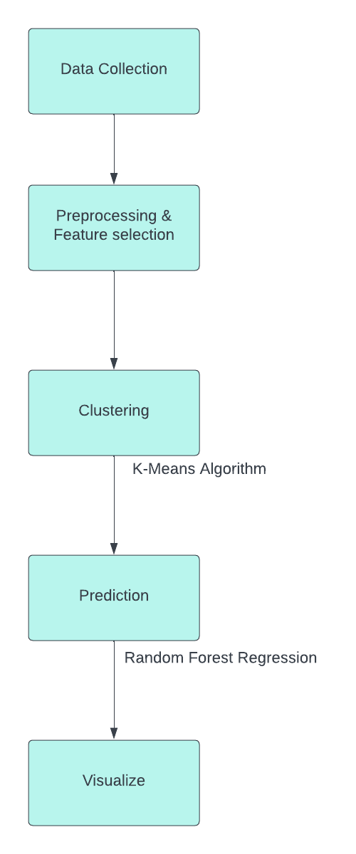
ARCHITECTURE
06/05/2023

Slide 14
METHODOLOGY
Random forest algorithm:
Random forest is a versatile algorithm capable of performing both regression and classification. It is commonly used to predict modelling with accuracy.
A random forest regression follows the concept of simple regression. Random Forest operates by constructing several decision trees during training time
Random forest regression, each tree produces a specific prediction. The mean prediction of the individual trees is the output of the regression.

Slide 15
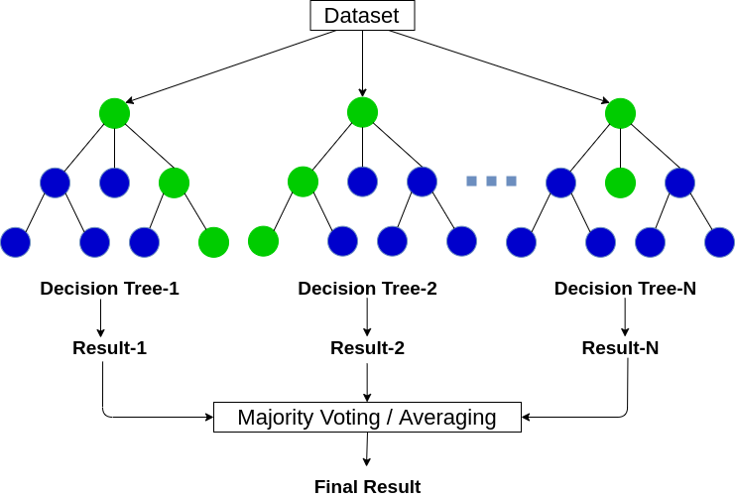
METHODOLOGY

Slide 16
METHODOLOGY
K-means algorithm:
The task is to categorize those items into groups. To achieve this, we will use the k-means algorithm, an unsupervised learning algorithm.
K-means creates k groups from a set of objects so that the members of a group are more similar.
K in the name of the algorithm represents the number of groups/clusters we want to classify our items into.

Slide 17
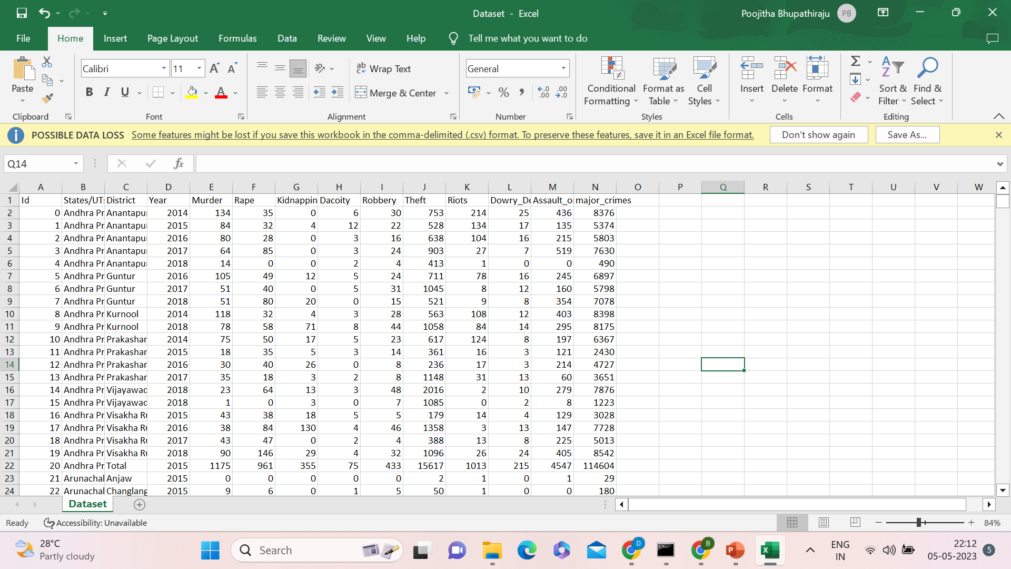
DATA SET
The dataset consists of 837 individual data.
14 attributes

Slide 18
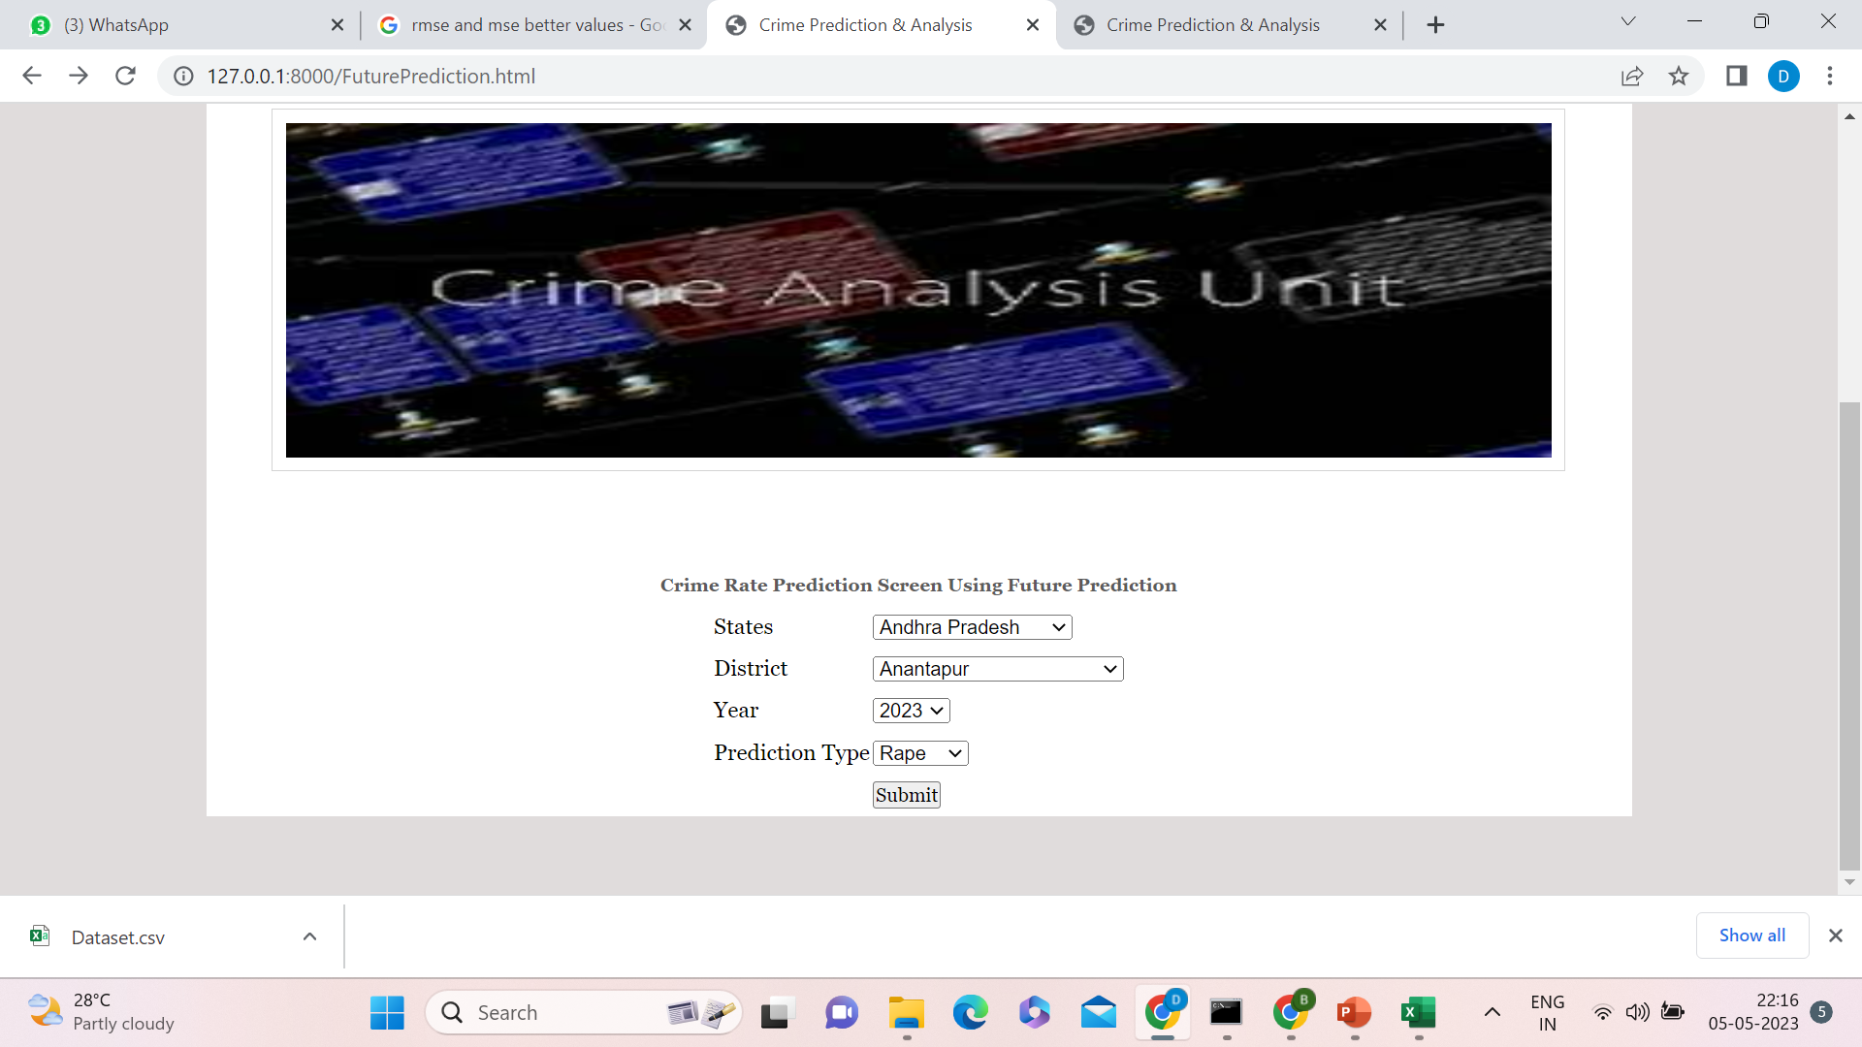
RESULTS

Slide 19
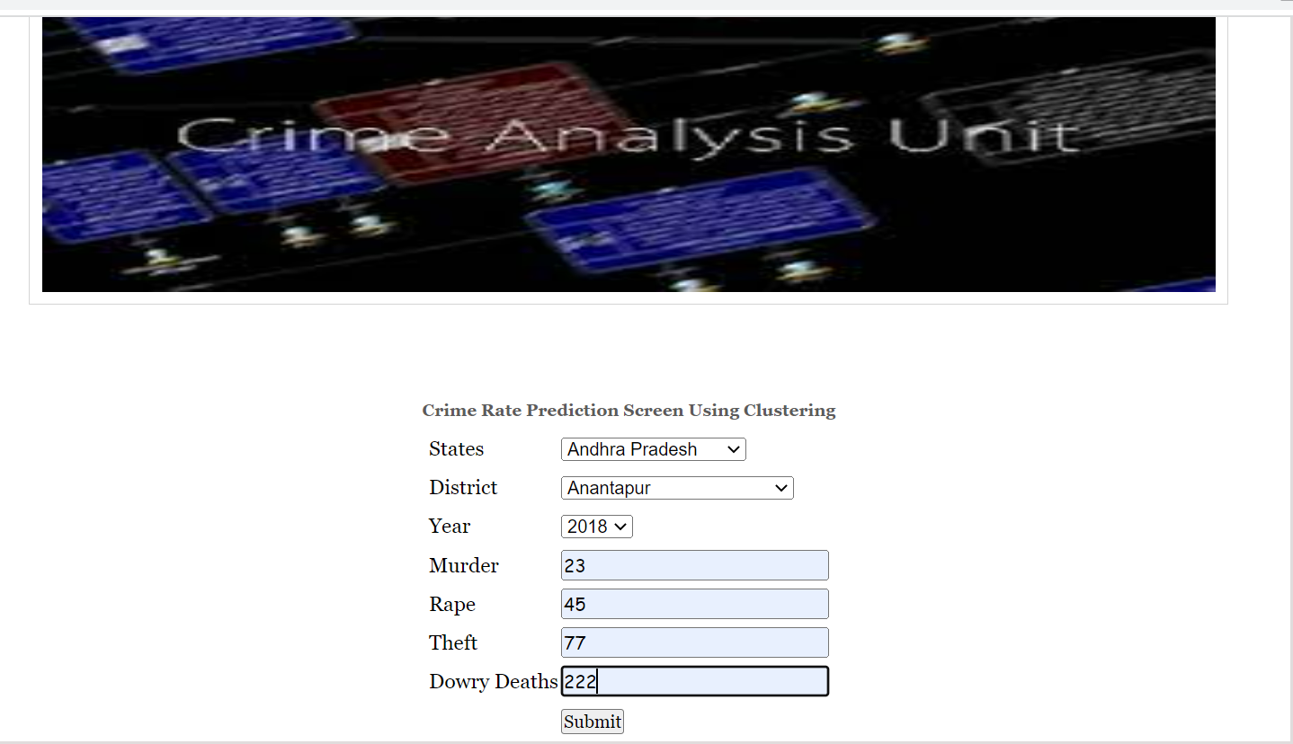
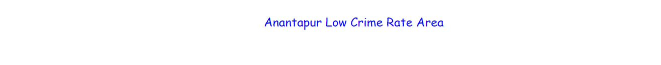
RESULTS

Slide 20
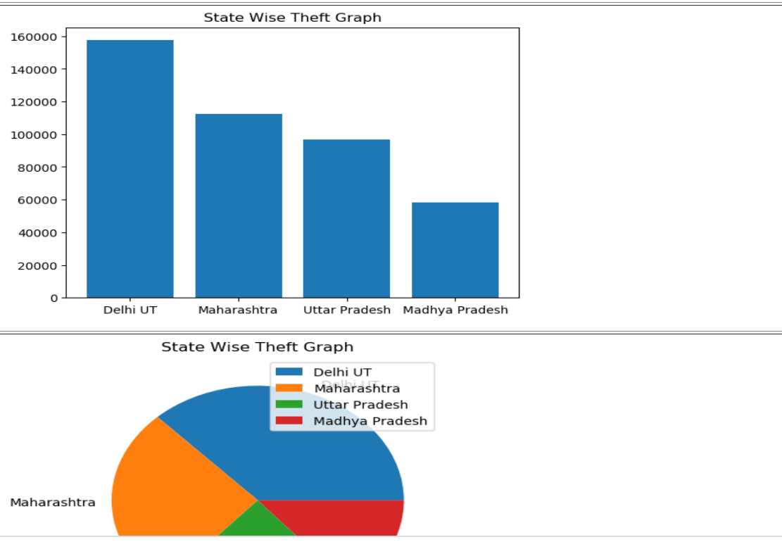
RESULTS

Slide 21

SOCIETAL IMPACT
Criminal activities are present in every region of the world affecting quality of life and socioeconomical development. As such, it is a major concern of many governments who are using different advanced technology to tackle such issues.
This prediction if put to good use is of great help in investigating cases and could be used to suppress the crimes by installing some measures.
This will indirectly help in reducing the crimes and shall improve the security in required areas.

Slide 22
CONCLUSION
In this project we are using clustering and regression algorithms to predict crime rate. Clustering algorithm is used to predict HIGH or LOW crime area and regression algorithms are used to forecast future crime rate. Visualization of dataset is done to analyse the crimes which gives better understanding visually.

Slide 23
FUTURE WORK
There is a lack of proper standards across the globe to record the crimes that happen. Even if the data is available, it is not easy to accommodate that data with another framework to achieve more concrete predictions. These are challenges for crime analysis to handle. These should be handled in future research.
As of now, the project will rely on manual input from a human (a police officer) in order to enter details in the database. If we can make this a centralised system and connect it to all the police stations countrywide and make FIR reporting digital, then it would be quite easier to predict crimes in that particular location and recognise patterns in them.

Slide 24
REFERENCES
[1] Akanksha Gahalot,Uprant,Suraina Dhiman,”Crime Prediction and Analysis”,(IEEE) Conference Paper-February 2021
[2] Akash,Aniket verma,Nidi Lal,Yash,“Crime Prediction Using K-Nearest Neighbouring Algorithm”, International,conference on emerging trends in information technology and engineering-2020
[3] Ch. Mahendra,G. Nani Babu,G. Balu Nitin Chandra,A. Avinash,“CRIME RATE PREDICTION”,journel of engineering stories(JES), Vol 11, Issue 5,May/2020
[4] Kirthika V, Krithika Padmanabhan A , Lavanya,”Prediction of Crime Rate Analysis Using Supervised Classification Machine Learning Approach”, (IRJET) Volume: 06| Mar 2019
[5] Suhong Kim, Param Joshi, Parminder Singh Kalsi,”Crime Analysis Through Machine Learning”, Fraser International College, Simon Fraser University Conference Paper-2018
06/05/2023

Slide 25
REFERENCES
[6] Varshitha D N, Aishwarya P, Sahana R, “Paper on Different Approaches for Crime Prediction system”, (IJERT), NCETEIT - 2017 Conference Proceedings
[7] Varshitha D N, Aishwarya P, Sahana R, “Paper on Different Approaches for Crime Prediction
system”, (IJERT), NCETEIT - 2017 Conference Proceedings
[8] H. Berestycki and J.-P. Nadal,” Self-organised critical hot spots of criminal activity” IEEE Access (Volume: 9), 03 February -2018
[9] A. Almehmadi, Z. Joudaki, and R. Jalali,”Language usage on Twitter predicts crime rates”
06/05/2023

Slide 26
THANK YOU
06/05/2023

